Slide 1
NFL Summary and Clustering Analysis 1970 - 2019
Amelia Green, Will Holt, Andrea Smith
March 16, 2020

Slide 2
Some of the questions that will be addressed include:
How many eras existed in the NFL from 1970 – 2019?
What were the trends in offensive statistics over time?
Who were the outliers in the modern era and did it translate to success?
Did total offense increase?
If so, was it driven by passing or rushing yards?
Did turnovers increase or decrease?
Did point differentials increase or decrease?
What other interesting findings are there?

Slide 3
Executive Summary
Identified 3 distinct clusters in the NFL since 1970 (merger of AFL and NFL)
1970-1978; 1979-2010; 2011-2019
Total offense and passing yards increased by more than 100 yards while rushing decreased by about 50 yards per game
Turnovers reduced and scoring increased
Outliers in total offense, passing yards, and rushing yards never won the Super Bowl
Outliers in rushing were 17-1 in the playoffs
Scoring differentials reduced over time, especially in the Super Bowl

Slide 4
Data was scraped and copied from ProFootballReference
Team-by-team results from 1966-2019
Data was subset to include 1970-2019 and excluded 1982
1970: AFL-NFL merger
1982: Strike-shortened season
1993: 18-week season with 2 bye weeks
Bye weeks: empty rows of data
Playoff rounds: Wild Card, Divisional, Conference Championship, Super Bowl
Offensive summaries from 1970-2019
Contained major statistical categories for all teams
Averages were based on a per team and per game basis due to 14-game schedule from 1970-1977, a 16-game schedule from 1978-2019, and a nine-game schedule in 1982
Modern dataset from 2011-2019
Contained a subset of offensive categories from the offensive summaries and only contained the cluster of 2011-2019
Used to detect outliers
Kmeans dataset
Contained season averages on a per team, per game basis
This normalized the data

Slide 5
Kmeans was used to identify different eras within the NFL to ensure similar season were analyzed
Kmeans algorithm randomly plots a pre-determined number of points on a graph, which are called centroids
Elbow Method helps determine the number of clusters
Additional points are plotted, and a measurement calculation is performed to determine which centroid the new data point is closest to
The centroid is adjusted based on the new data point as well and the process repeats until the smallest distance for each cluster is established
Allows for better comparisons between different seasons
It may not make sense to compare the 1976 and 2018 seasons
Profiles of seasons can be created
Useful for marketing (customer segmentation and targeting), and other business applications

Slide 6
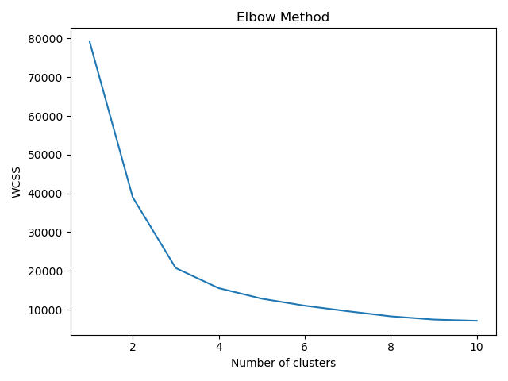
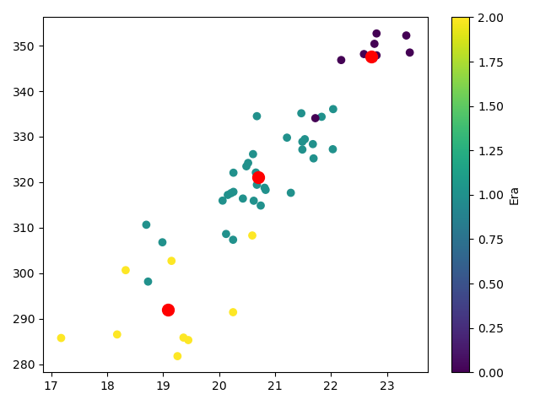
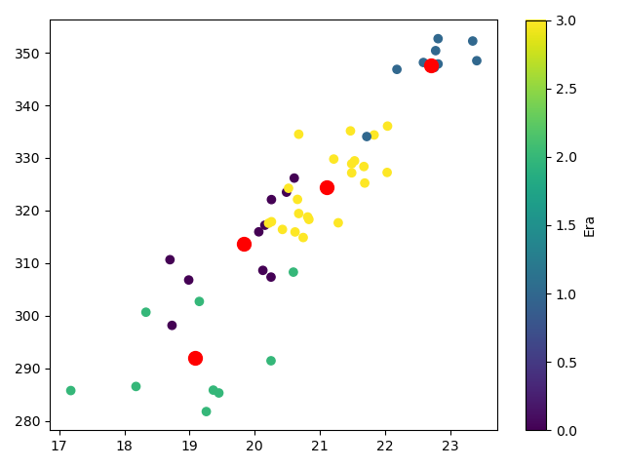
Despite overlap with the clusters it was obvious that a modern era emerged
The elbow method suggested to use 3 or 4 clusters
Regardless of clusters the modern was easily identified
3 clusters were applied to analysis
3 clusters
4 clusters

Slide 7
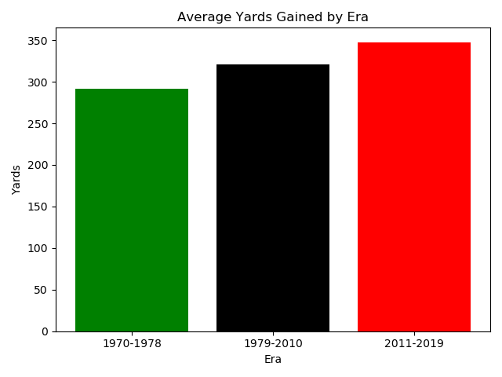
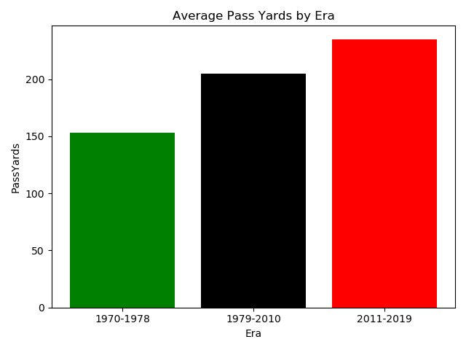
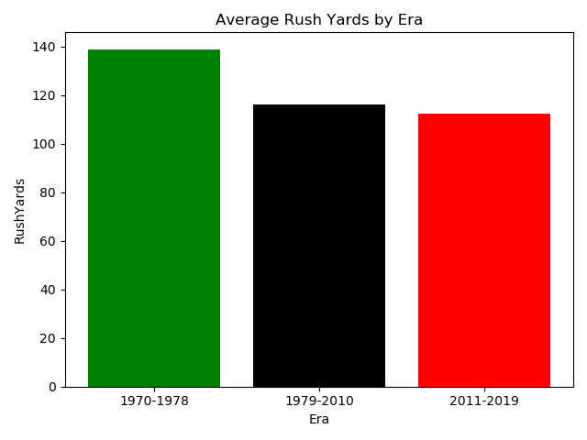
Modern era is defined from 2011 to 2019
Yards and pass yards increased over time while rush yards decreased and flattened
Delta from 1970-1978 to 2011-2019 clusters:
Total yards increase: 111.8/game
Pass yards increase: 163.8/game
Rush yards decrease: 52.6/game

Slide 8
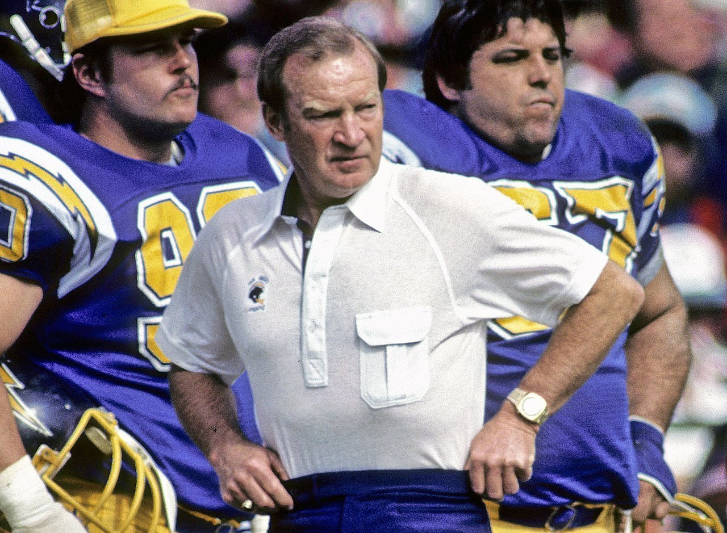
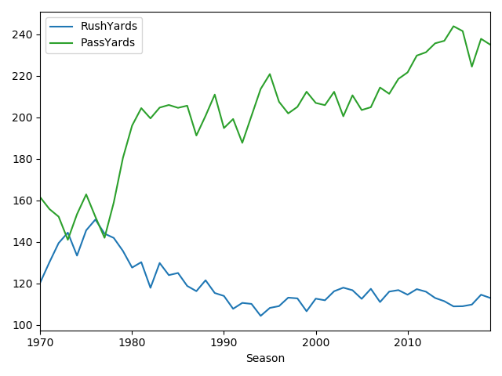
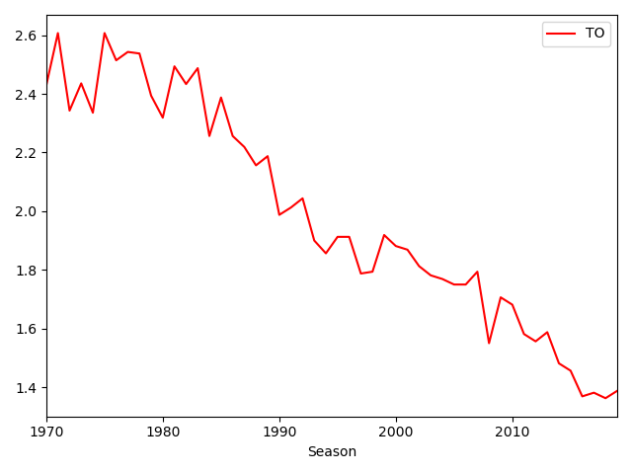
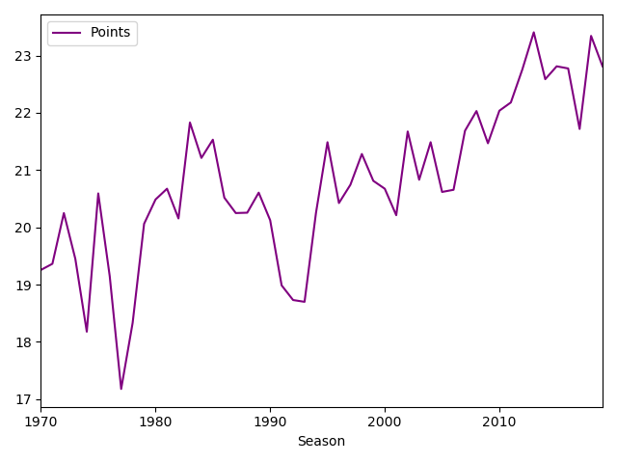
Despite the prominence of the passing game, turnovers decreased
Passing years contributed to 57.3% of the offense in 1970; Passing yards contributed to 67.5% of total offense in 2019
Turnovers per team dropped to 1.3 in 2019
Teams combined to score 45 points in 2019
Don Coryell, considered an innovator with the passing game. Coached Chargers from ‘78-’86

Slide 9
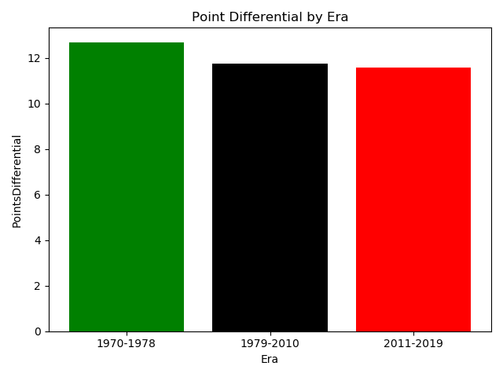
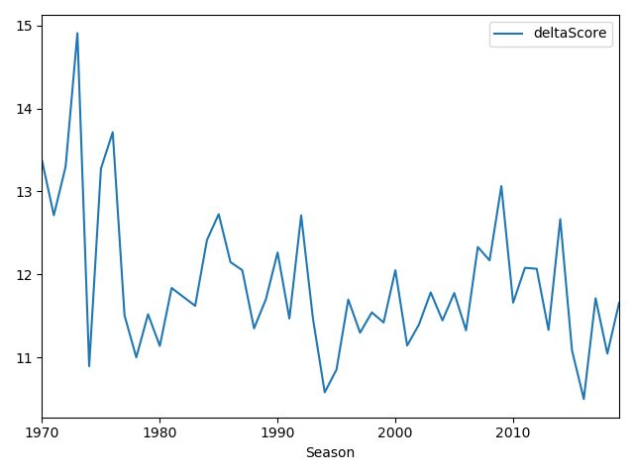
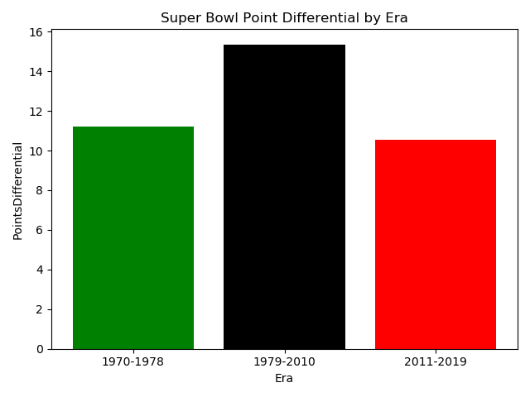
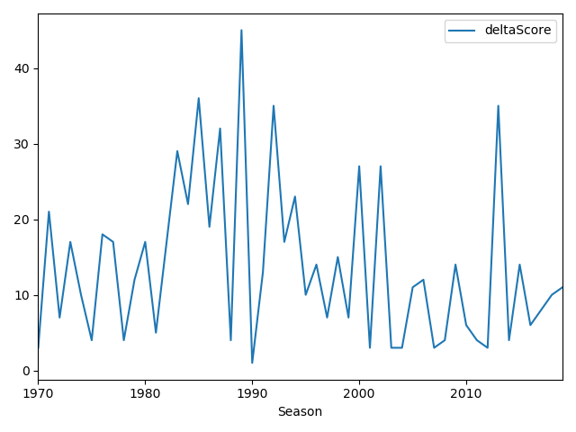
Point differentials during the Super Bowl are similar between 2011-2019 and 1970-1978 eras
Regular season
Super Bowl

Slide 10
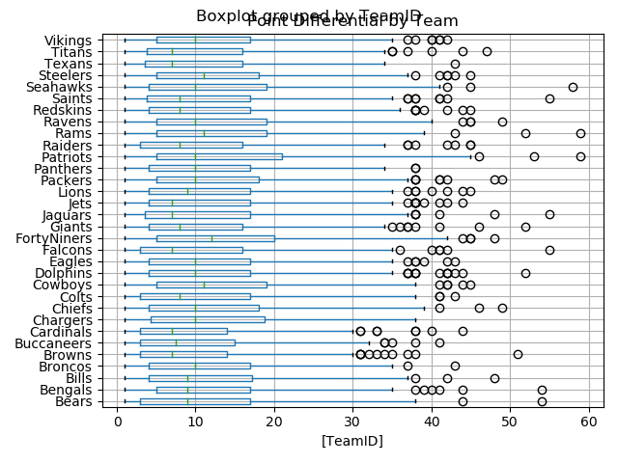
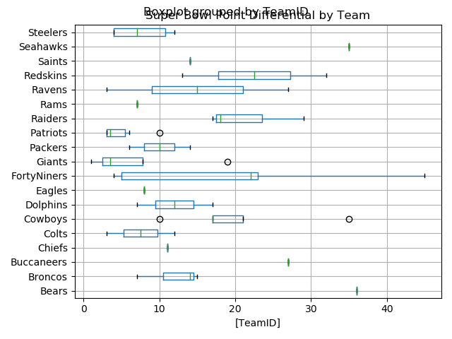
The Patriots and Rams are tied for the biggest win margin: 59 points
Rams beat Falcons 59-0 in 2004
Patriots beat the Titans 59-0 in 2009
49ers beat Broncos 55-10 in Super Bowl XXIV
Regular Season Differentials
Super Bowl Differentials

Slide 11
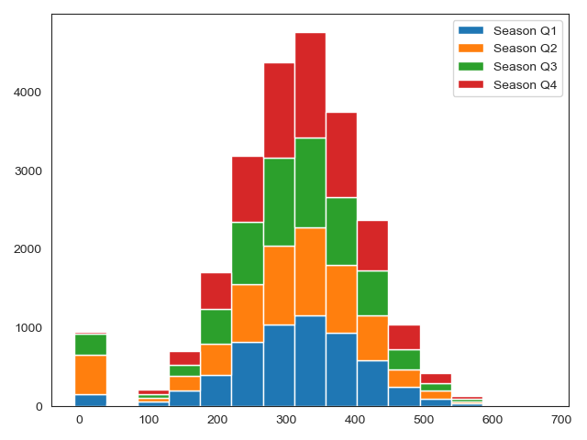
Points scored by week remained consistent throughout the season
Analysis reviewed the points scored by each week in the NFL to determine if teams were scoring more in a particular timeframe
Weeks were grouped together as follows:
Season Q1: Weeks 1-4
Season Q2: Weeks 5-8
Season Q3: Weeks 9-12
Season Q4: Weeks 13-18*
*18 weeks in 1993 season (two bye weeks)

Slide 12
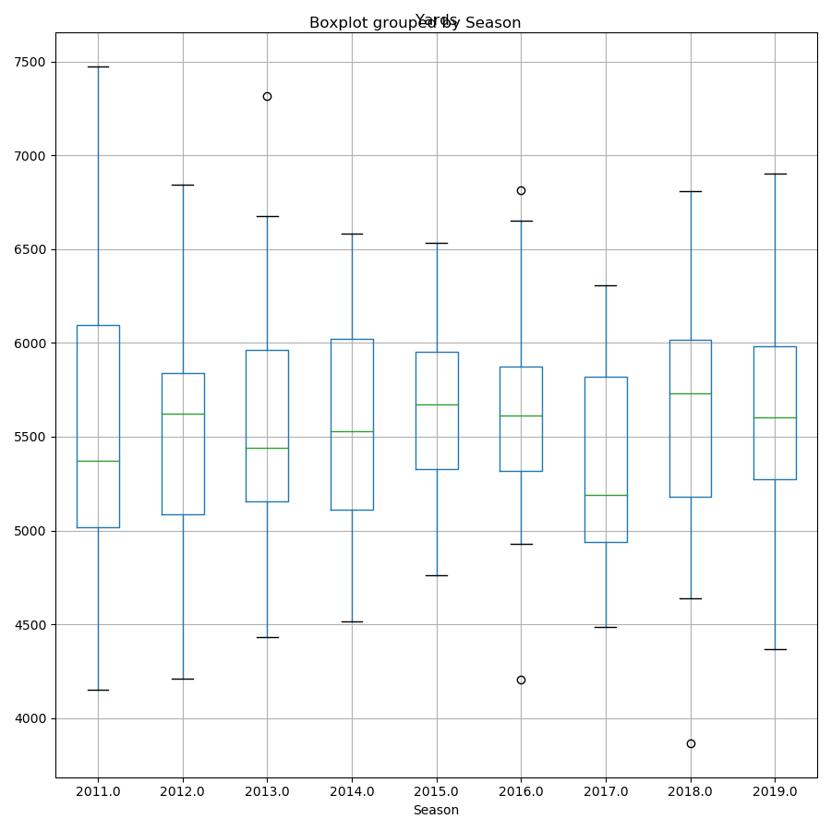
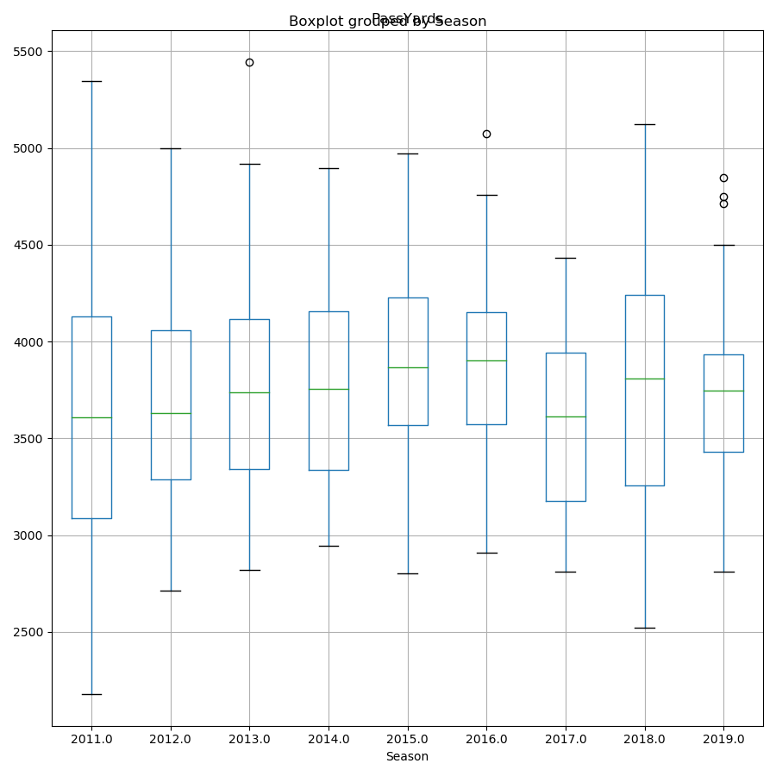
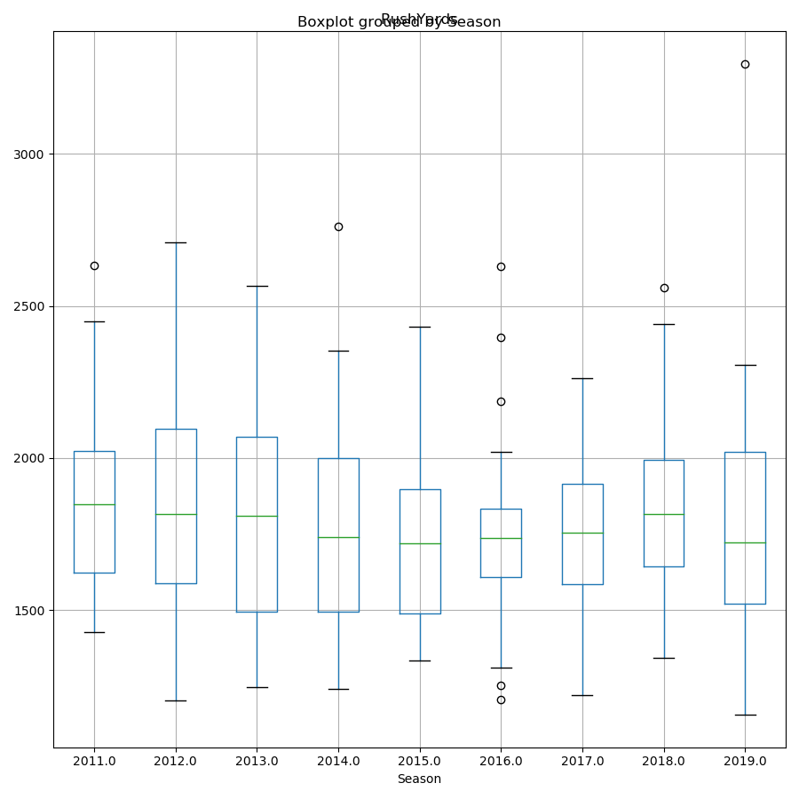
Four of the five positive outliers in passing yards missed the playoffs
Positive outlier
Negative outlier
Outlier Season Result
Broncos 2013 L, Super Bowl
Saints 2016 Missed Playoffs
Rams 2016 Missed Playoffs
Cardinals 2018 Missed Playoffs
Outlier Season Result
Broncos 2013 L, Super Bowl
Saints 2016 Missed Playoffs
Buccaneers 2019 Missed Playoffs
Falcons 2019 Missed Playoffs
Cowboys 2019 Missed Playoffs
Outlier Season Result
Broncos 2011 L, Division
Seahawks 2014 L, Super Bowl
Bills 2016 Missed Playoffs
Cowboys 2016 L, Division
Titans 2016 Missed Playoffs
Seahawks 2018 L, Wild Card
Ravens 2019 L, Division
Vikings 2016 Missed Playoffs
Rams 2016 Missed Playoffs
Total Yards
Pass Yards
Rush Yards

Slide 13
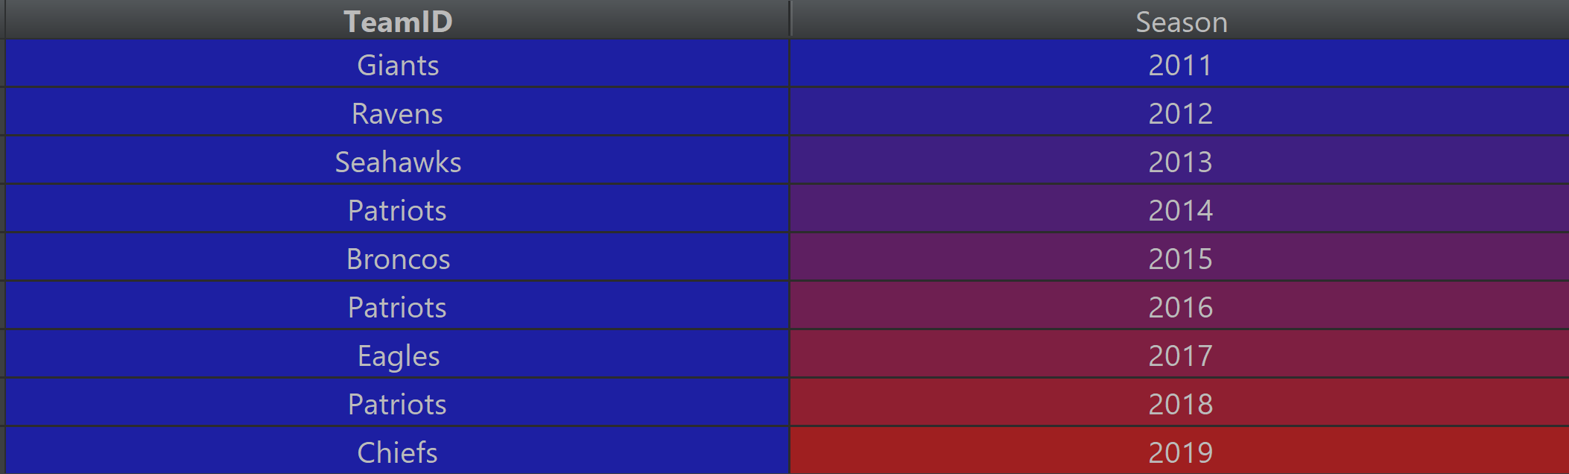
Patriots won three Super Bowls during the ‘11-’19 era but never an outlier in yards
Data point for Super Bowl winning team
Total Yards
Pass Yards
Rush Yards

Slide 14
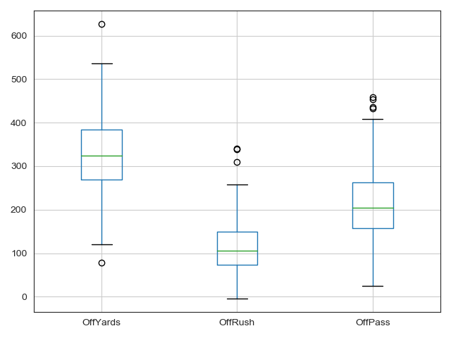

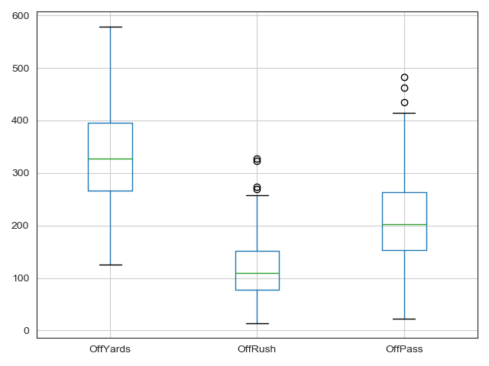

Teams that with exceptional rushing performances were 10-1 in the Wild Card and Divisional Rounds
Team | Opponent | Category | Yards | Result
Saints | Lions | Total | 626 | W
Bills | Dolphins | Rush | 341 | W
Cowboys | Rams | Rush | 338 | W
Broncos | Jaguars | Rush | 310 | W
Saints | Lions | Pass | 459 | W
Colts | Broncos | Pass | 454 | W
Colts | Chiefs | Pass | 436 | W
Dolphins | Bills | Pass | 432 | L
Team | Opponent | Category | Yards | Result
Falcons | Rams | Rush | 327 | W
49ers | Packers | Rush | 323 | W
Rams | Cowboys | Rush | 273 | W
Rams | Cowboys | Rush | 269 | W
Jaguars | Dolphins | Rush | 257 | W
Bengals | Seahawks | Rush | 254 | W
Browns | Dolphins | Rush | 251 | L
Broncos | Dolphins | Rush | 250 | W
Browns | Jets | Pass | 483 | W
Steelers | Jaguars | Pass | 462 | L
Saints | 49ers | Pass | 435 | L

Slide 15

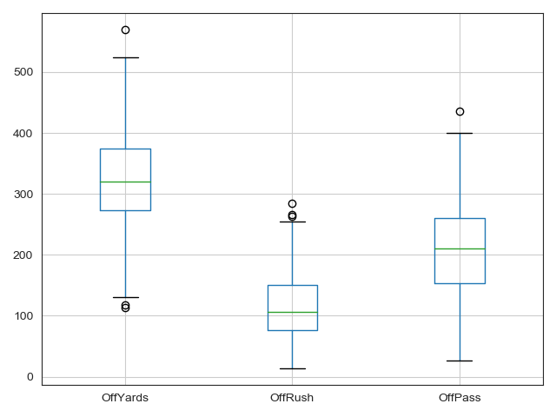
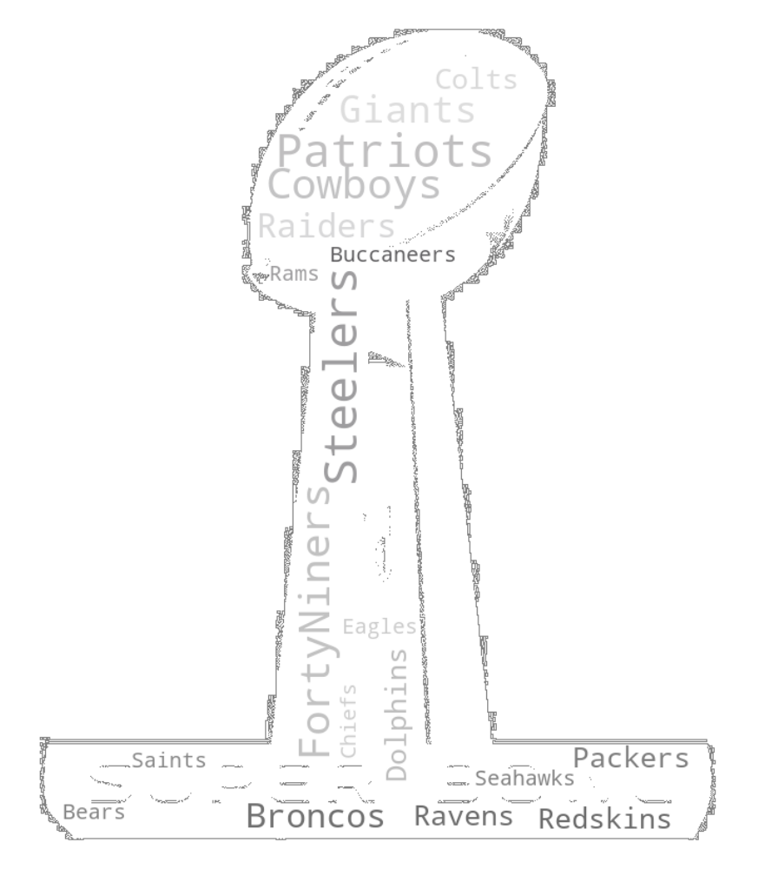
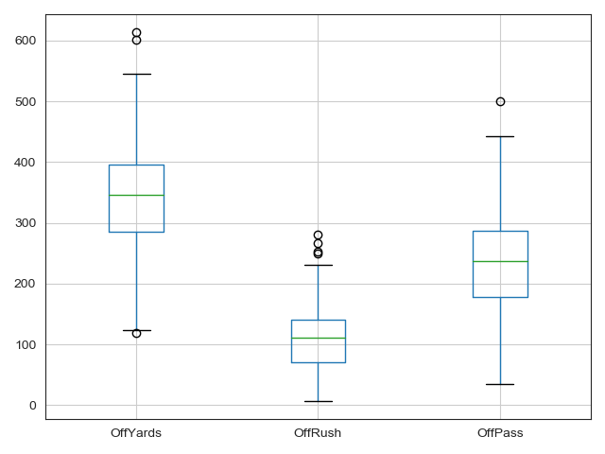
The trend continues as teams went 7-0 in the Conference Championships and Super Bowl
Team | Opponent | Category | Yards | Result
Dolphins | Steelers | Total | 569 | W
49ers | Packers | Rush | 285 | W
Dolphins | Raiders | Rush | 266 | W
Eagles | Cowboys | Rush | 263 | W
Dolphins | Steelers | Pass | 435 | W
Team | Opponent | Category | Yards | Result
Patriots | Eagles | Total | 613 | L
Redskins | Broncos | Total | 602 | W
Redskins | Broncos | Rush | 280 | W
Raiders | Vikings | Rush | 266 | W
Cowboys | Dolphins | Rush | 252 | W
Steelers | Vikings | Rush | 249 | W
Patriots | Eagles | Pass | 500 | L

